Slide 1
ACRS
User Manual Guide
SOI-2021-2120-0019

Slide 2
Table of Contents
User Manual Guide for :
Public Users
User (Security Guard)
Admin (Estate Officer)

Slide 3
Public Users

Slide 4
Introduction
Public users are anyone who access the page without logging into the system
They will able to see:
Home Page
Login Page
About Page
Appeal Page

Slide 5
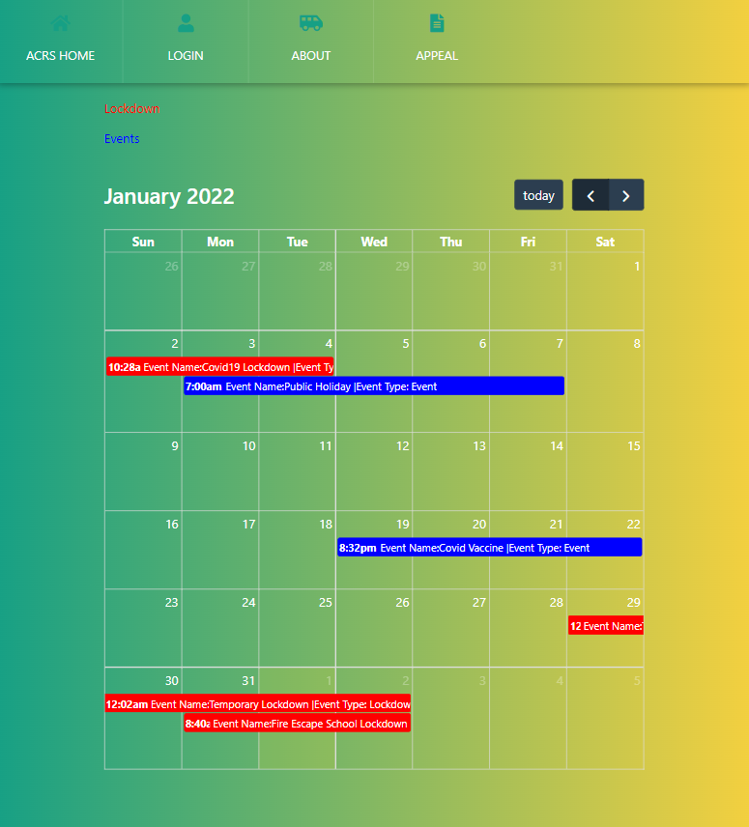
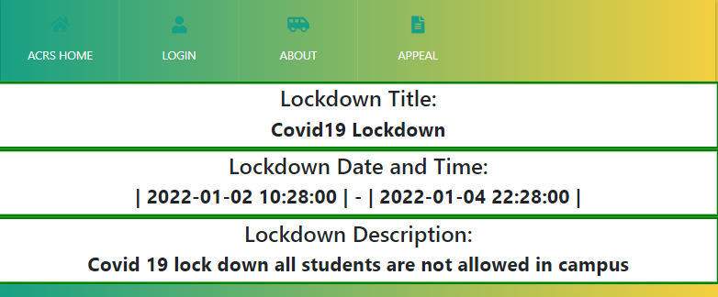
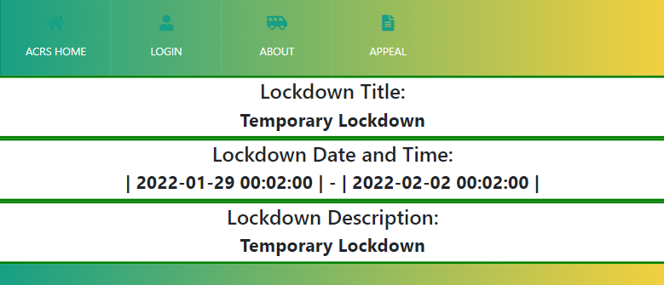
ACRS Home
Upon accessing https://acrsproject.pythonanywhere.com/
it will display the home page.
This is a sub menu where users can select which page they would like to navigate to
The text colour represents the different calendar highlights
Users are able to view the calendar to see the dates for Lockdown and Events
Users are able to click on the highlighted boxes to view the details of the events.
Once the user clicks on the blue highlighted boxes representing Events, it directs the user to a new tab
Once the user clicks on the blue highlighted boxes representing Lockdown, it direct the user to a new tab

Slide 6
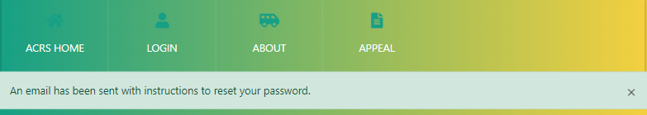
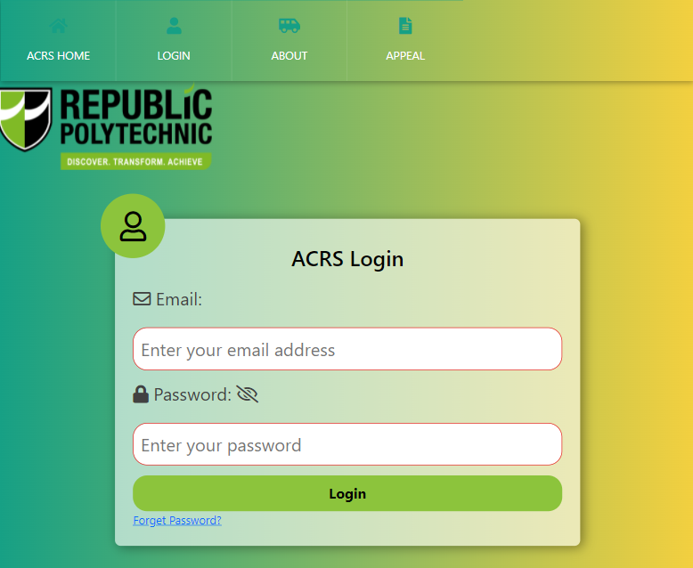
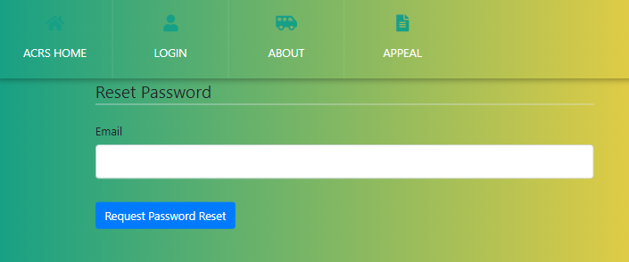
Login
Users such as:
Security Guard
Estate Officer
Will be able to login into the system with their email and password.
Users can hide or unhide the password
Users who forget their password are able to reset the password by clicking “Forget Password?”
Users will have to fill in their email and receive a link for them to reset their password

Slide 7
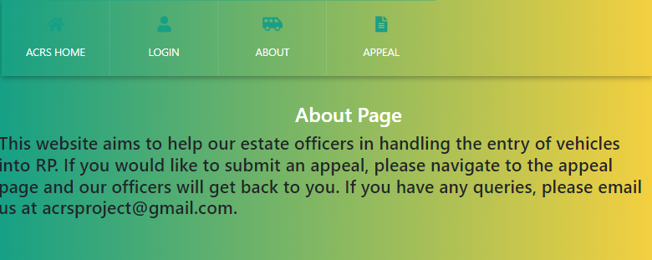
About Page
A brief explanation on how our website and project works.

Slide 8
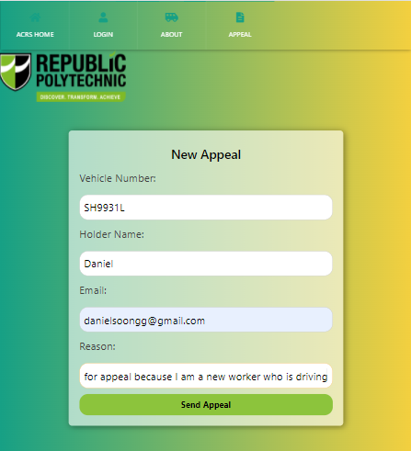
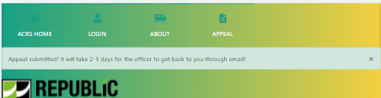
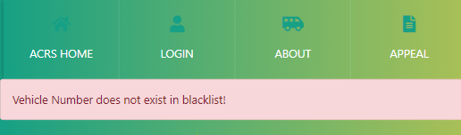
Appeal Page
If the vehicle number exists in the blacklist,
If the vehicle does not exist in the blacklist
Public users can submit an appeal for their blacklisted vehicle through this page.
Once submitted the public users will be notified if their vehicle has been removed from the blacklist via email.

Slide 9
User (Security Guard)

Slide 10
Introduction
Users are Security Guard who can logging into the system
They can view:
Login Page
Home Page
Account Page
My Profile
Vehicle Page
Vehicle Entry Screening
Vehicle Tracking
Posts Page
All Posts
Feedback
Bug

Slide 11
Login
Users such as:
Security Guard
Estate Officer
Will be able to login into the system with their email and password.
Users can hide or unhide the password
Users who forget their password are able to reset the password by clicking “Forget Password?”
Users will have to fill in their email and receive a link for them to reset their password

Slide 12
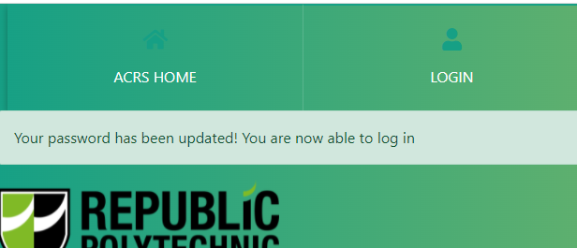
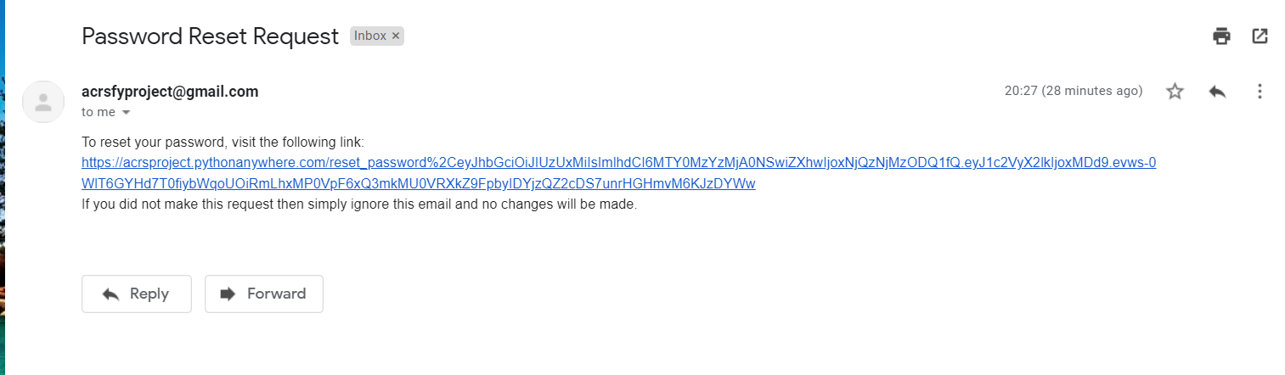
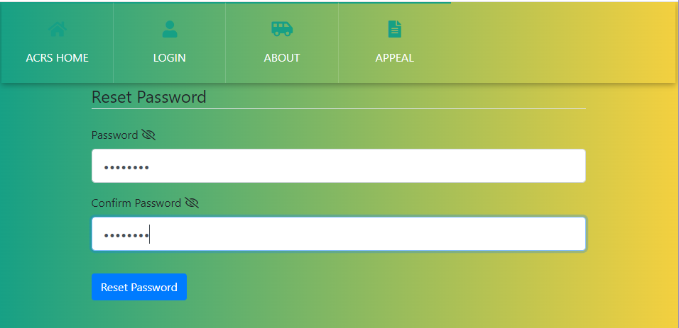
Forgotten Password Process
If the user requests a password reset, they should receive a special link for them to reset their password
Once clicked, it will bring the user to change their password

Slide 13
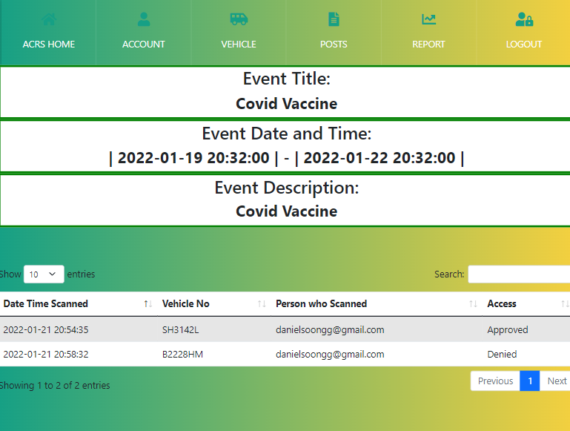
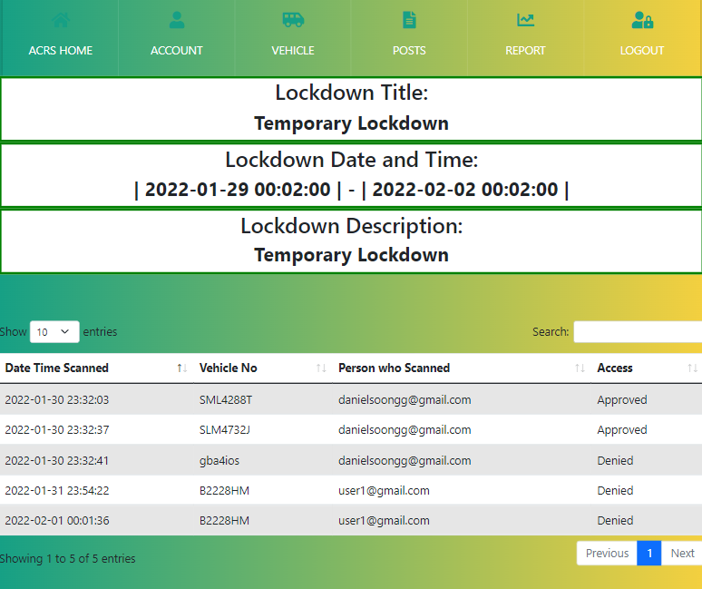
ACRS Home
Upon accessing https://acrsproject.pythonanywhere.com/
it will display the home page.
This is a sub menu where users can select which page they would like to navigate to
The text colour represents the different calendar highlights
Users are able to view the calendar to see the dates for Lockdown and Events
Users are able to click on the highlighted boxes to view the details of the events.
Once the user clicks on the blue highlighted boxes representing Events, it directs the user to a new tab that shows a list of cars coming into the school that day.
Once the user clicks on the blue highlighted boxes representing Lockdown, it direct the user to a new tab that shows a list of cars coming into the school that day.

Slide 14
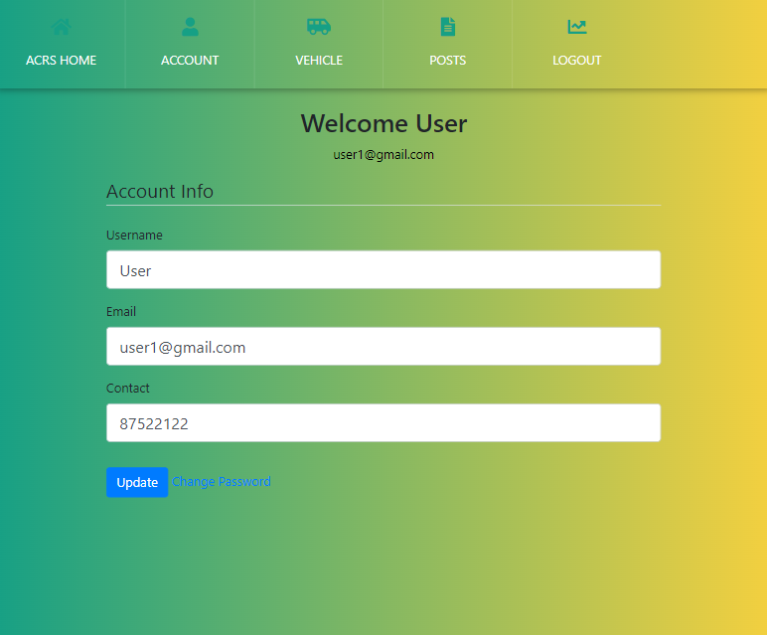
Account Page - My Profile
Users are able to update their details by clicking on “My Profile” under the “Account” sub-menu.
Users are able to change their password in the event that they forget.

Slide 15
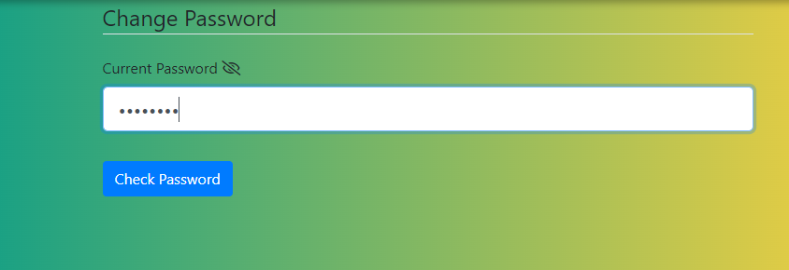
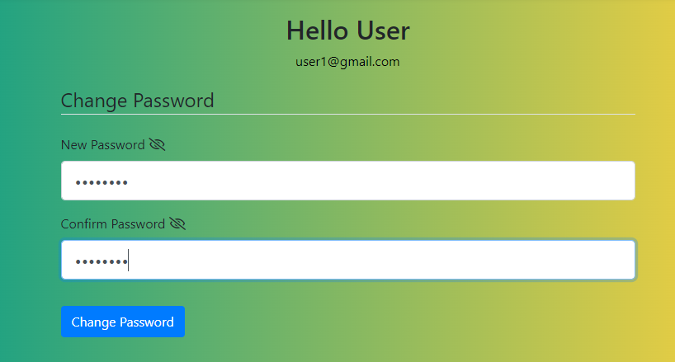
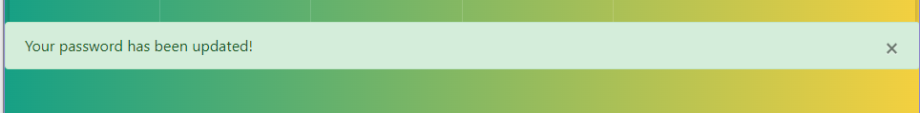
Change Password Process
Users will have to key in their current password in order to update their password.
Users can then change to the password they want and they have to confirm their current password in order to make changes.
Once password has been changed successfully, a success message pop up.

Slide 16
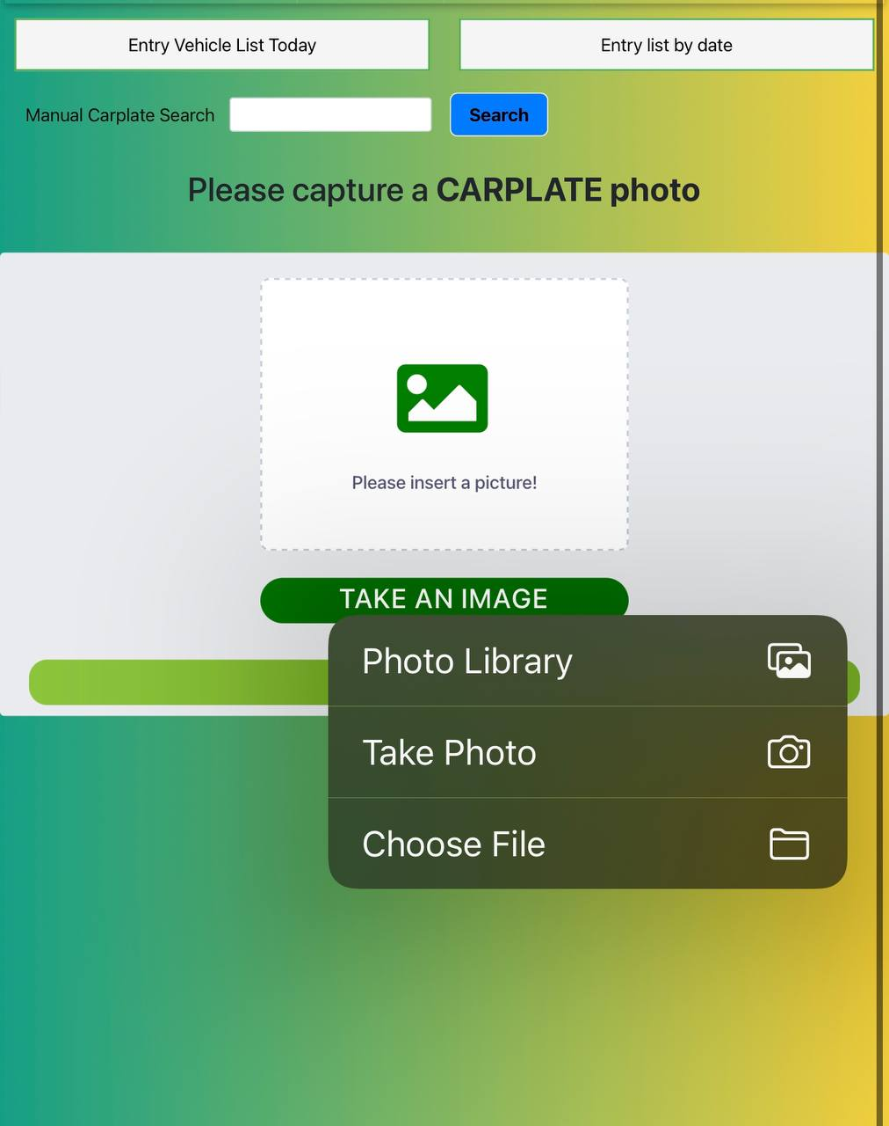
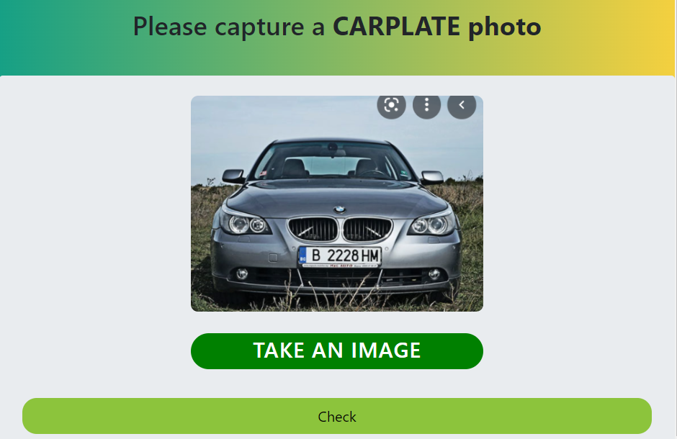
Vehicle Page - Vehicle Entry Screening
This will check if the vehicle is allowed in
Republic Polytechnic
Users are able do a manual search if they are not able to upload or take picture
Users are able to take a picture or choose a picture in their phone library
The system only accept image ONLY
If the image show the car plate numbers, the system will be able to detect the car plate number

Slide 17
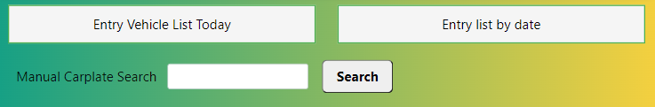
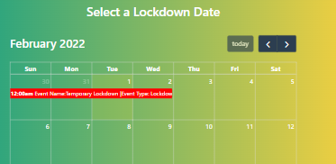
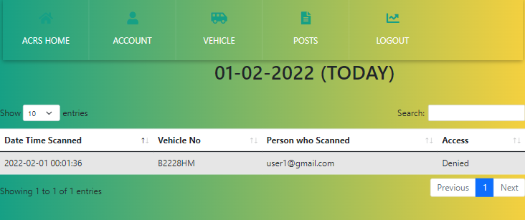
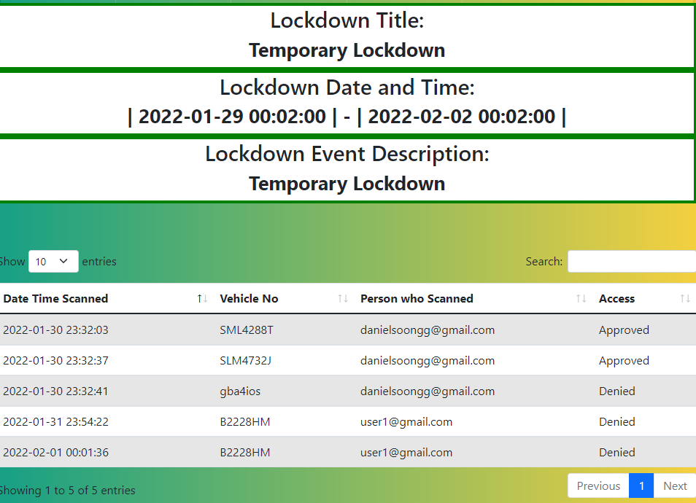
Vehicle Entry - Entry Vehicle List Today and by Date
If the user clicks “Entry List by Date”, it will allow the user to select the date of which the vehicles come in
If the user clicks
“Entry Vehicle by Today”
It will then display the lockdown details and the vehicle that come in on this lockdown from the latest date and time to the earliest.
It will display the vehicle that has entered RP on that day

Slide 18
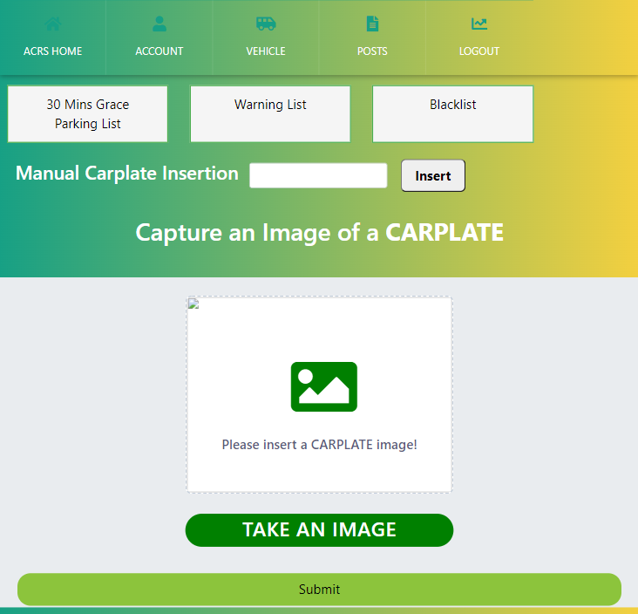


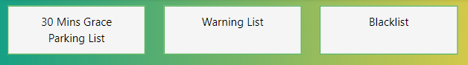
Vehicle Page - Vehicle Tracking
Track Vehicle Function
The buttons redirect users to the different lists.
The users are able to do a manual search and take or upload a picture similar to the entry vehicle screening.

Slide 19
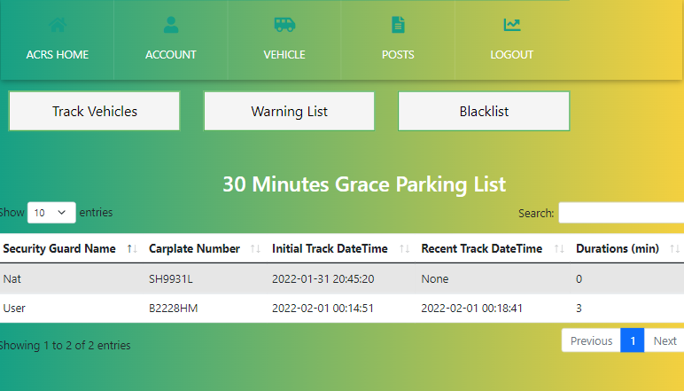
Vehicle Page - Vehicle Tracking
30 Minutes Grace Parking Function
Users can click on the buttons to display the different lists
Users can change the number of entries they want to be shown on a page
Admins can search through the list based on the keywords entered
Users are able to filter through the list by Descending or Ascending order using the arrows
Durations more than 30 minutes will automatically be transferred to warning list
The Car Plate Number will be listed in the “30 Mins Grace Parking List” immediately after the Security Guard scans an illegally parked car
Users can navigate through pages by either clicking on “Previous”, “Next” or the number(s)
“Initial Track Date Time” is inputted when the Security Guard scans the car plate for the first time on a particular day
“Recent Track Date Time” will be inputted subsequently after the Security Guard scans the same car plate number for the second time of the same day

Slide 20
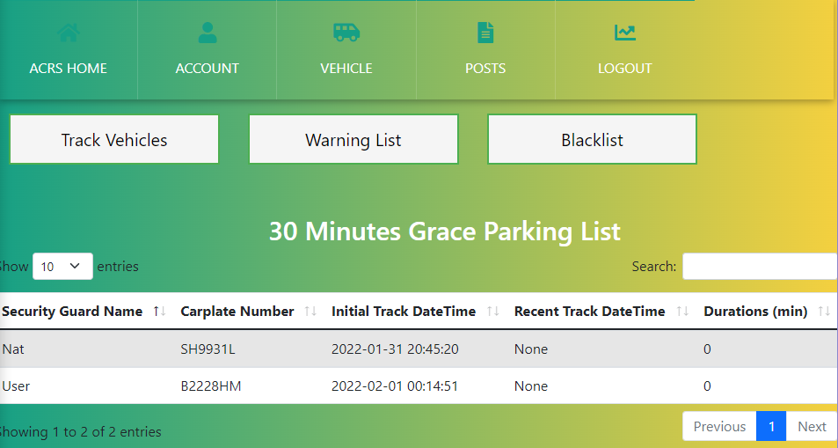
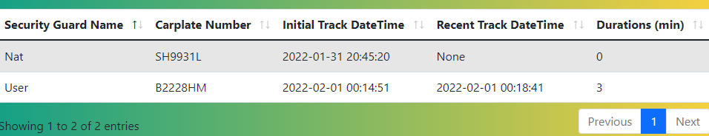
Vehicle Page - Vehicle Tracking (Cont)
30 Minutes Grace Parking Function
1st scanned “B2228HM
2nd scanned “B2228HM
When the user scans a certain car for the second time, it will be displayed under the “Recent Track DateTime”.
This column will show the duration that the car has illegally parked for. The car plate will be transferred to the warning list when the duration exceeds the 30 Minutes Grace Period
When the user first scans the car plate, it will display the carplate number with the initial date and time the car parked illegally in school.

Slide 21
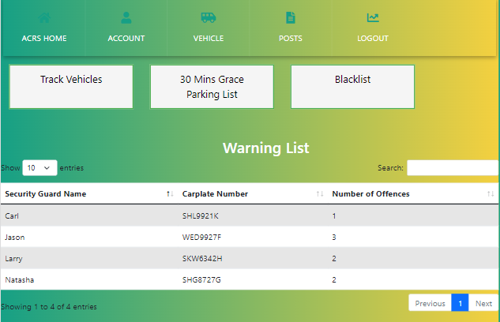

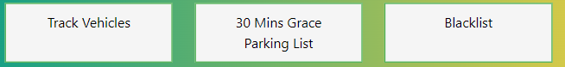
Vehicle Page - Vehicle Tracking
Warning Function
Users can click on the buttons to display the different lists
Users can change the number of entries they want to be shown on a page
Admins can search through the list based on the keywords entered
Users are able to filter through the list by Descending or Ascending order using the arrows
Number of Offences will keep accumulating until it reaches 5 after which the carplate Number will automatically be transferred to the Blacklist and its status will be updated
The carplate number will automatically be listed in the Warning List when found to be parked illegally for more than 30 minutes
Users can navigate through pages by either clicking on “Previous”, “Next” or the number(s)

Slide 22
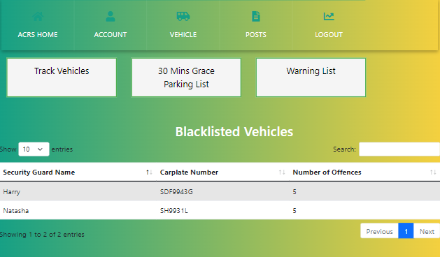
Vehicle Page - Vehicle Tracking
Blacklist Function
Users can click on the buttons to display the different lists
Users can change the number of entries they want to be shown on a page
Users can search through the list based on the keywords entered
Users are able to filter through the list by Descending or Ascending order using the arrows
The carplate number will automatically be listed in the Blacklist when the Number of Offences exceeds 5
Users can navigate through pages by either clicking on “Previous”, “Next” or the number(s)

Slide 23
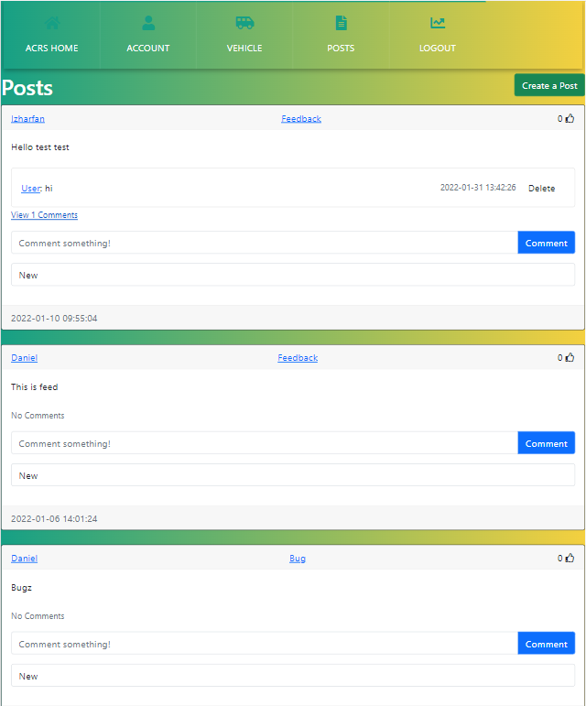
Posts Page - All Posts
It will redirect users to a page where they can create a post
Consist of Feedback and Bug Posts
It will redirect users to Feedback Post page
Users can click on the Delete button to remove their own comment or comments on their own post.
Users can click on the link to view comments
Users can click on the thumbs-up icon to give the post a like
Users can click on their name to view all of their posts
Users can comment on posts
It will redirect the user to “Bug Post” page
Users can view the status of the post

Slide 24
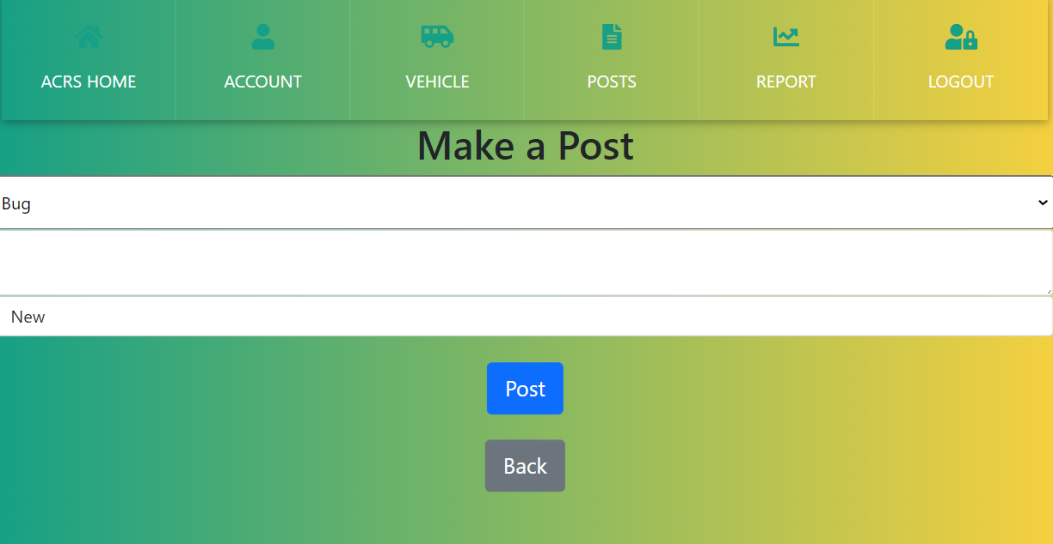
Process of Creating a Post
Users can choose the type of Post they are writing by clicking on the dropdown menu
Users can type in their feedback or bug issues here
Users can click the “Post” button to make a post
The status will automatically be set to “New” when a new post is made
Users can click “Back” to go to the previous page

Slide 25
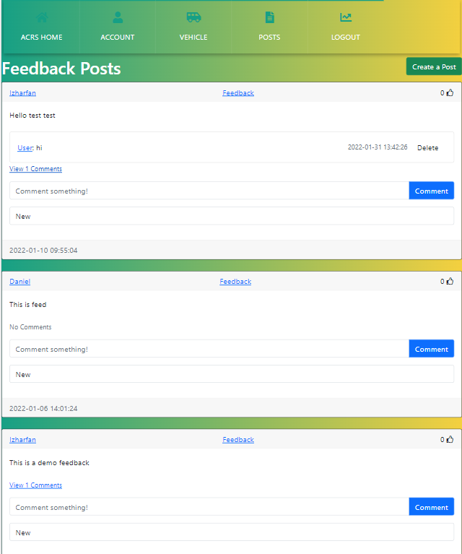
Posts Page - Feedback
It will redirect users to a page where they can create a post
Consists of only Feedback Posts
Users can click on the link to view comments
Users can click on the Delete button to remove their own comment or comments on their own post.
Users can click on the thumbs-up icon to give the post a like
Users can click on their name to view all of their posts
Users can comment on posts
Users can view the status of the post

Slide 26
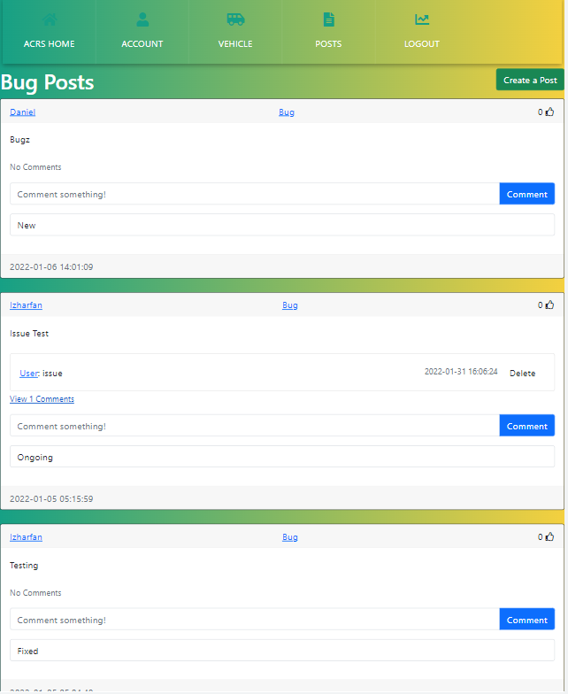
Posts Page - Bug
It will redirect users to a page where they can create a post
Consist of only Bug Posts
Users can click on the thumbs-up icon to give the post a like
Users can click on the Delete button to remove their own comment or comments on their own post.
User can click on the link to view comments
Users can comment on posts
Users can click on their name to view all of their posts
Users can view the status of the post

Slide 27
Admin (Estate Officer)

Slide 28
Introduction
Admins are Estate Officer who can logging into the system and have the authority to access more functions
They can view:
Login Page
Home Page
Account Page
My Profile
User Management
User Audit
Vehicle Page
Vehicle Entry Screening
Vehicle Tracking
Vehicle Management
Appeal Management
Posts Page
All Posts
Feedback
Bug
Report Page

Slide 29
Login
Users such as:
Security Guard
Estate Officer
Will be able to login into the system with their email and password.
Users can hide or unhide the password
Users who forget their password are able to reset the password by clicking “Forget Password?”
Users will have to fill in their email and receive a link for them to reset their password

Slide 30
Forgotten Password Process
If the user requests a password reset, they should receive a special link for them to reset their password
Once clicked, it will bring the user to change their password

Slide 31
ACRS Home
Upon accessing https://acrsproject.pythonanywhere.com/
it will display the home page.
This is a sub menu where users can select which page they would like to navigate to
The text colour represents the different calendar highlights
Users are able to view the calendar to see the dates for Lockdown and Events
Users are able to click on the highlighted boxes to view the details of the events.
Once the user clicks on the blue highlighted boxes representing Events, it directs the user to a new tab that shows a list of cars coming into the school that day.
Once the user clicks on the blue highlighted boxes representing Lockdown, it direct the user to a new tab that shows a list of cars coming into the school that day.

Slide 32
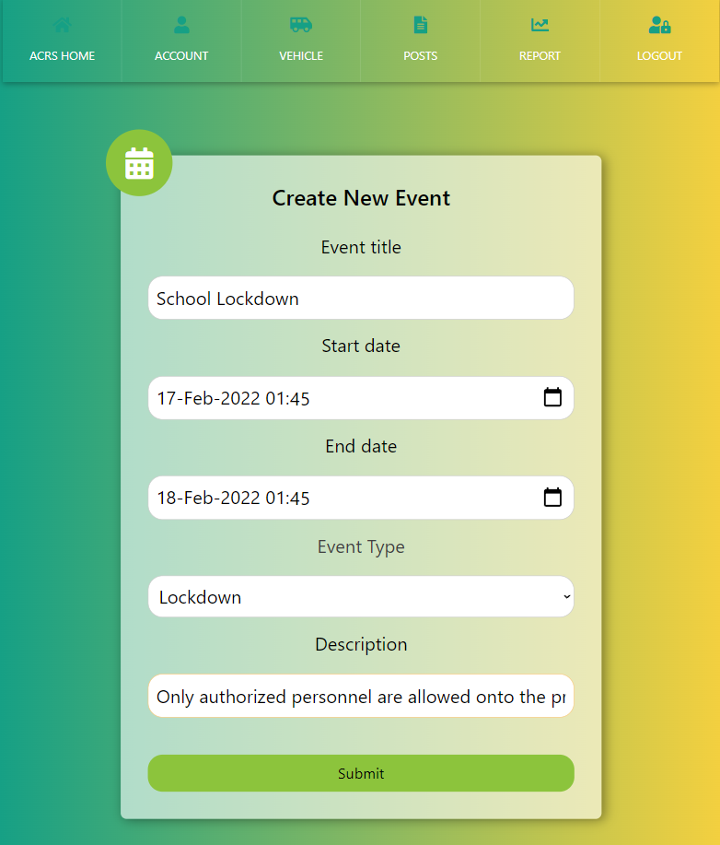
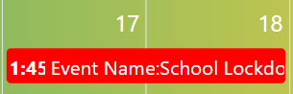
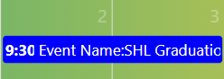
Home Page - Add Event
Admins are able to create a new event and choose the event type to be either a “Lockdown” or “Event”
If the Admin created:
Lockdown - The event will be shown in the calendar highlighted in “Red”
Event - The event will be shown in the calendar highlighted in “Blue”

Slide 33
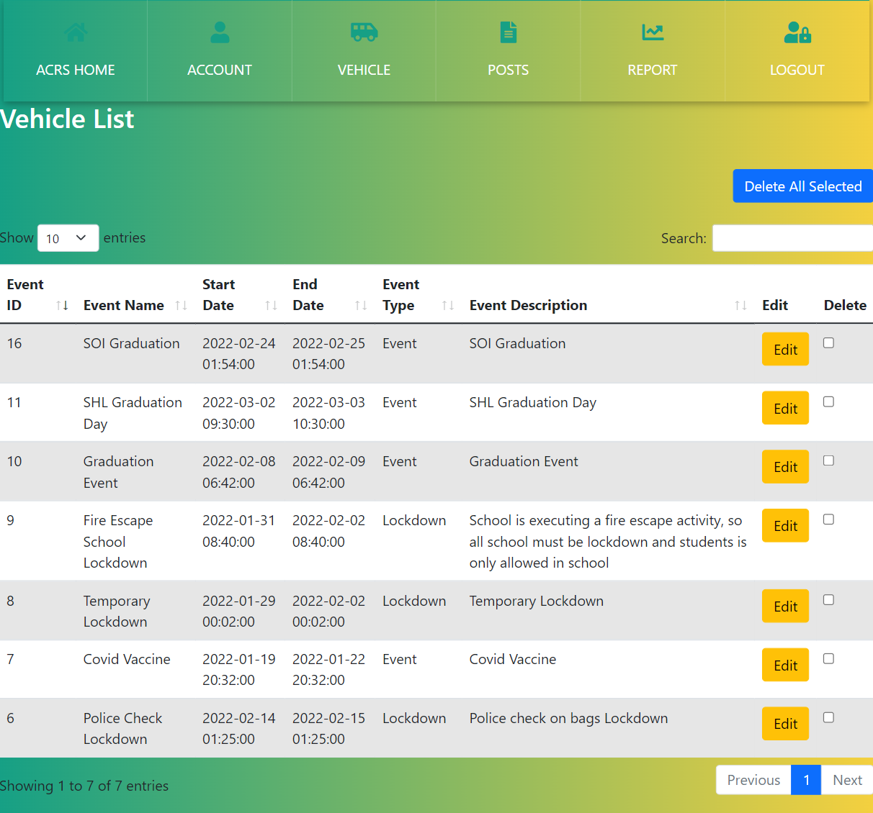
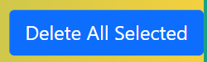
Home Page - Event List
Admins can change the number of entries they want to be shown on a page
Admins can search through the list based on the keywords entered
Admins are able to edit or delete through the list
Admins are able to filter through the list by Descending or Ascending order using the arrows
Admins are able to check which rows they want to delete by clicking on the checkboxes followed by the “Delete All Selected” button
Admins can navigate through pages by either clicking on “Previous”, “Next” or the number(s)

Slide 34
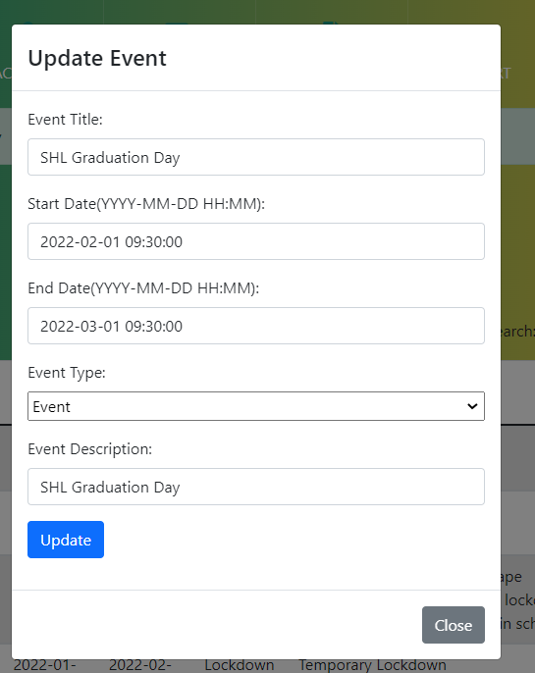
Home Page - Edit Events
Admins are able to edit the event details
Once the admin clicks on the “Update” button it will save any changes made.
Admins have to update the date by “YYYY-MM-DD HH:MM” format if they wish to make any changes.

Slide 35
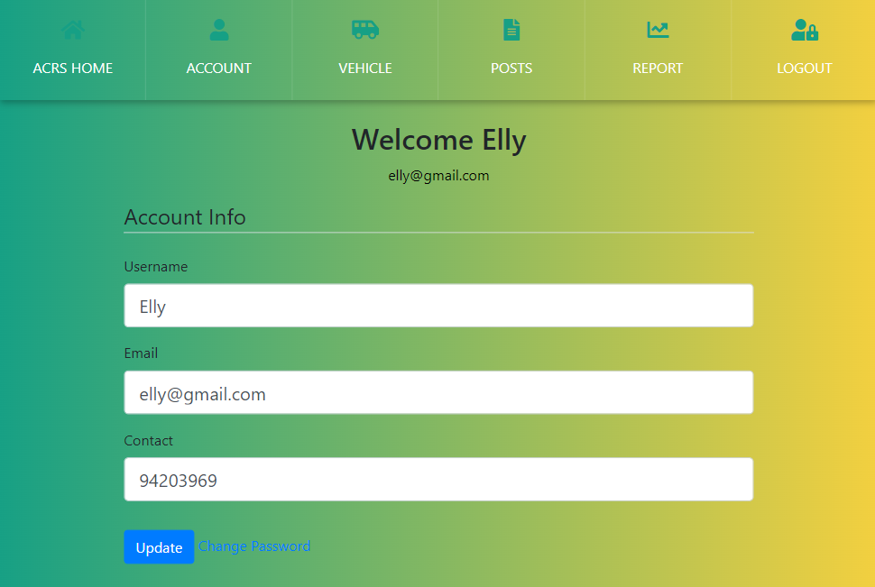
Account Page - My Profile
Admins are able to update their details via “My Profile”
Admins are able to change their password

Slide 36
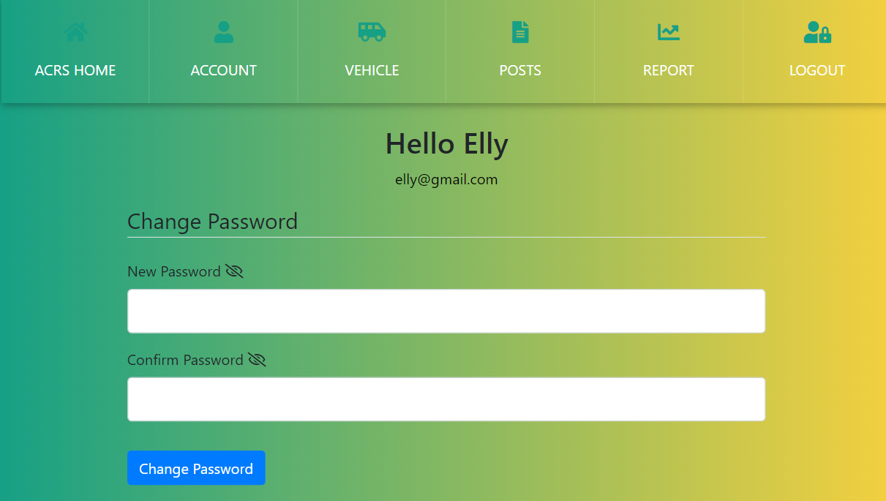
Change Password Process
Hello Admin
admin@gmail.com
Admins will have to verify their current password in order to update their password.
Admins can then change to the password they want and they have to confirm their current password in order to make changes.
Once password has been changed successfully, a success message pop up.

Slide 37
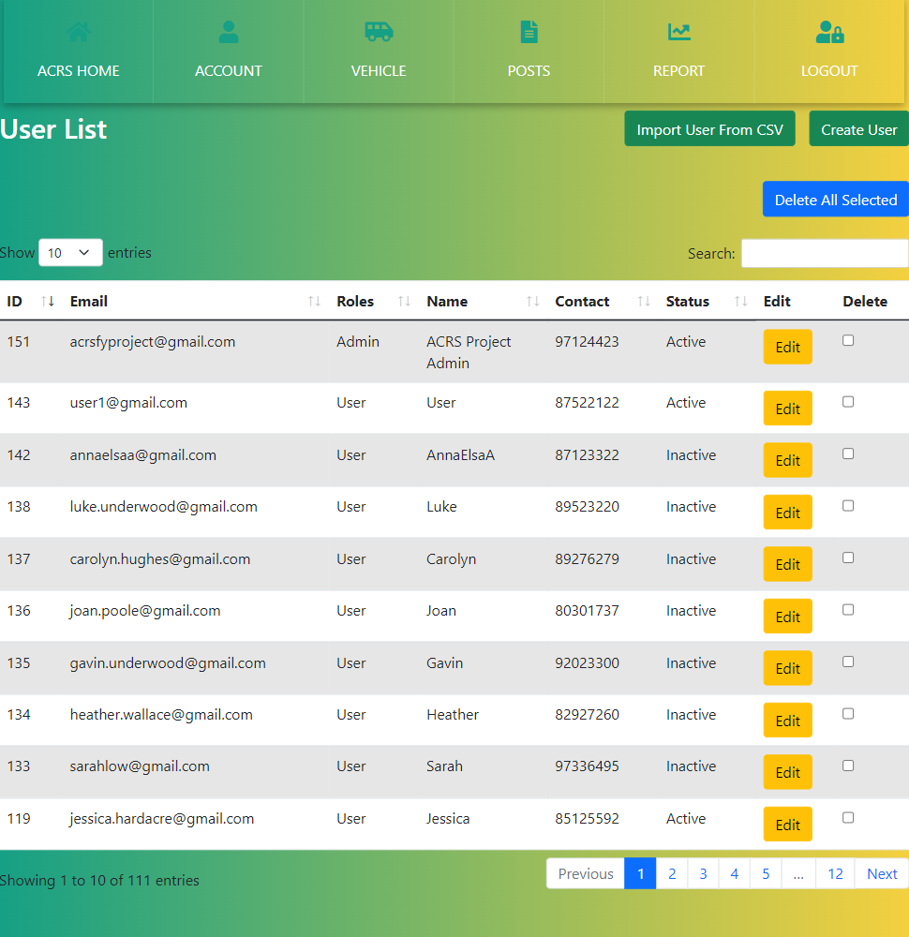
Account Page - User Management
Admins are able to import users from csv files to create a new users
Admins can change the number of entries they want to be shown on a page
Admins can search through the list based on the keywords entered
Admins are able to filter through the list by Descending or Ascending order using the arrows
Admin are able to edit or delete rows in the list
Admins are able to select which rows they want to delete by clicking on the checkboxes followed by the “Delete All Selected” button
Admins can navigate through pages by either clicking on “Previous”, “Next” or the number(s)

Slide 38
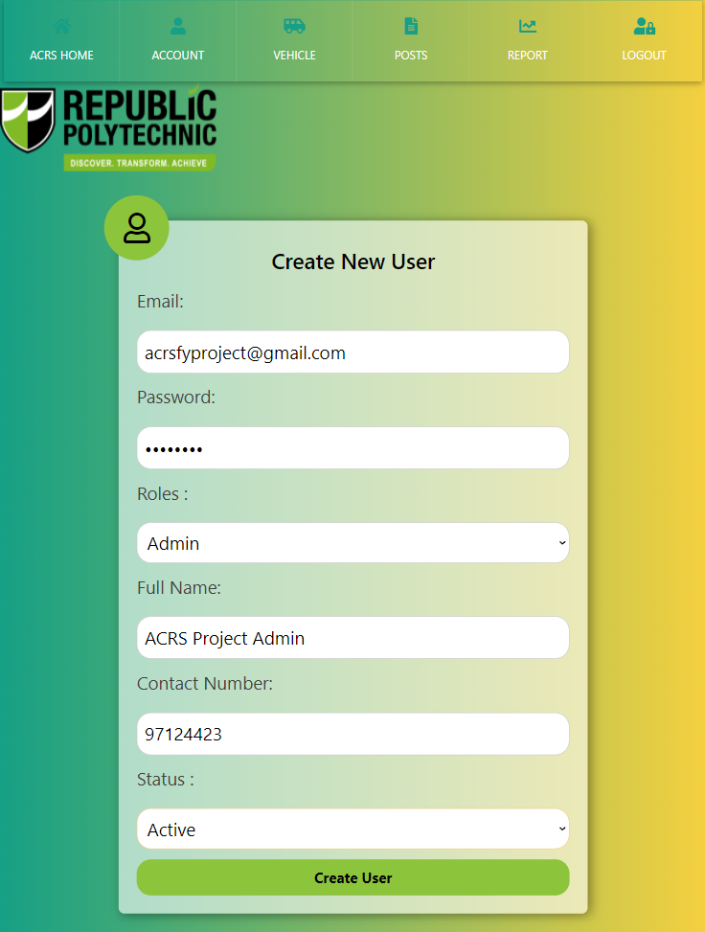
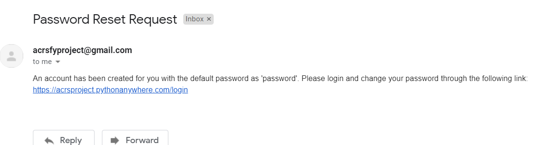
Account Page - Add Users
Once created, an email will be sent to the users email address. The new user will have to change their password from the one originally set by the admin.
Admins will have to create a new user and fill in all the details. Once done click on “Create User” to make an account.
Once created:
The new user will receive an email asking the user to change the password

Slide 39
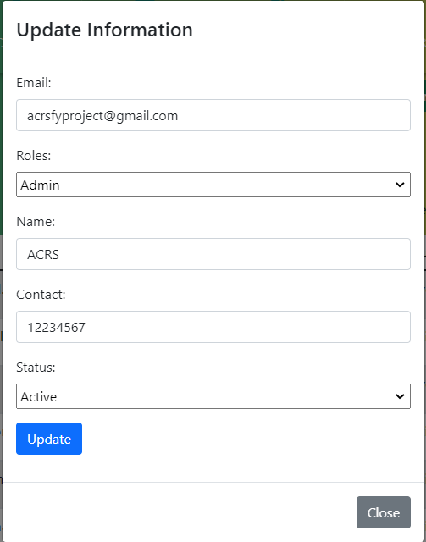
Account Page - Edit Users
Admins are able to make changes to any of the users’ details
Admins can save changes by clicking on “Update”

Slide 40
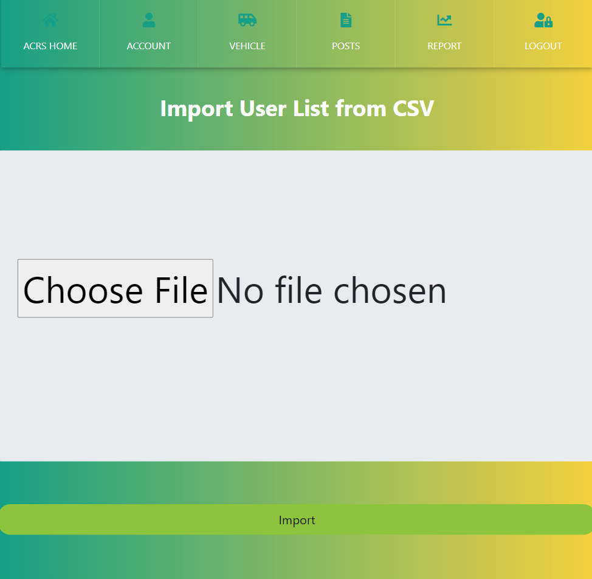

Account Page - Import user from CSV
Only CSV files are able to be uploaded. Once the file is uploaded, click “Import” insert the user list into the database.
The CSV file must contain data with the columns in this sequence:
Email
Password
Role
Name
Contact
Else, the file will not be able to be read.

Slide 41

Account Page - User Audit
Admins can change the number of entries they want to be shown on a page
Admins can search through the list based on the keywords entered
Admins are able to filter through the list by Descending or Ascending order using the arrows
Actions done by each user or admin will be tracked and listed in the User Audit
Admins can navigate through pages by either clicking on “Previous”, “Next” or the number(s)

Slide 42
Vehicle Page - Vehicle Entry Screening
This will check if the vehicle is allowed in
Republic Polytechnic
Admins are able do a manual search if they are not able to upload or take picture
Admins are able to take a picture or choose a picture in their phone library
The system only accept image ONLY
If the image show the car plate numbers, the system will be able to detect the car plate number

Slide 43
Vehicle Entry - Entry Vehicle List Today and by Date
If the admin clicks “Entry List by Date”, it will allow them to select the date of which the vehicles come in
If the admin clicks
“Entry Vehicle by Today”
It will then display the lockdown details and the vehicle that come in on this lockdown from the latest date and time to the earliest.
It will display the vehicle that has entered RP on that day

Slide 44
Vehicle Page - Vehicle Tracking
Track Vehicle Function
The buttons redirect admins to the different lists.
The admins are able to do a manual search and take or upload a picture similar to the entry vehicle screening.

Slide 45



Vehicle Page - Vehicle Tracking
30 Minutes Grace Parking Function
Admins can click on the buttons to display the different lists
Admins can change the number of entries they want to be shown on a page
Admins can search through the list based on the keywords entered
Admins are able to filter through the list by Descending or Ascending order using the arrows
Durations more than 30 minutes will automatically be transferred to warning list
The Car Plate Number will be listed in the “30 Mins Grace Parking List” immediately after the Security Guard scans an illegally parked car
Admins can delete entries
Admins can navigate through pages by either clicking on “Previous”, “Next” or the number(s)
“Initial Track Date Time” is inputted when the Security Guard scans the car plate for the first time on a particular day
“Recent Track Date Time” will be inputted subsequently after the Security Guard scans the same car plate number for the second time on the same day

Slide 46
Vehicle Page - Vehicle Tracking (Cont)
30 Minutes Grace Parking Function
1st scanned “B2228HM
2nd scanned “B2228HM
When the admin scans a certain car for the second time, it will be displayed under the “Recent Track DateTime”.
This column will show the duration that the car has illegally parked for. The car plate will be transferred to the warning list when the duration exceeds the 30 Minutes Grace Period
When the admin first scans the car plate, it will display the carplate number with the initial date and time the car parked illegally in school.

Slide 47

Vehicle Page - Vehicle Tracking
Warning Function
Admins can click on the buttons to display the different lists
Admins can change the number of entries they want to be shown on a page
Admins can search through the list based on the keywords entered
Admins are able to filter through the list by Descending or Ascending order using the arrows
Number of Offences will keep accumulating until it reaches 5 after which the carplate Number will automatically be transferred to the Blacklist and its status will be updated
The carplate number will automatically be listed in the Warning List when found to be parked illegally for more than 30 minutes
Admins can delete entries
Admins can navigate through pages by either clicking on “Previous”, “Next” or the number(s)

Slide 48

Vehicle Page - Vehicle Tracking
Blacklist Function
Admins can click on the buttons to display the different lists
Admins can change the number of entries they want to be shown on
a page
Admins can search through the list based on the keywords entered
Admins are able to filter through the list by Descending or Ascending order using the arrows
Admins can delete entries
Admins can navigate through pages by either clicking on “Previous”, “Next” or the number(s)
The carplate number will automatically be listed in the Warning List when found to be parked illegally for more than 30 minutes

Slide 49

Vehicle Page - Vehicle Management
Admins are able to import users from csv files to create a new users
Admins can change the number of entries they want to be shown on a page
Admins can search through the list based on the keywords entered
Admin are able to edit or delete rows in the list
Admins are able to filter through the list by Descending or Ascending order using the arrows
Admins are able to select which rows they want to delete by clicking on the checkboxes followed by the
“Delete All Selected” button
Admins can navigate through pages by either clicking on “Previous”, “Next” or the number(s)

Slide 50

Vehicle Page - Add New Vehicle
Admins are able to manually create a new vehicle to be added into the list. This would allow the car to be authorised to enter RP during a lockdown.

Slide 51

Vehicle Page - Edit Vehicle
Admins are able to make changes to the vehicles’ details
All changes will be saved once the “Update” button is clicked and a popup will be shown

Slide 52


Vehicle Page - Import Vehicle from CSV
Only CSV files are able to be uploaded. Once the file is uploaded, click “Import” insert the vehicle list into the database.
The CSV file must contain data with the columns in this sequence:
Vehicle No
Holder Name
Holder Type
Car Make
Company
Else, the file will not be able to be read.
Admin can choose to either reset the whole vehicle list in the database or add on the data from the CSV file

Slide 53


Vehicle Page - Appeal Management
Admins are able to approve appeals for blacklisted vehicles to remove them from the blacklist. Once the appeal is approved or rejected, an email will be sent to the email linked to the appeal.

Slide 54
Posts Page - All Posts
It will redirect admins to a page where they can create a post
Consist of Feedback and Bug Posts
It will redirect admins to Feedback Post page
Admins can click on the Delete button to remove their own comment or comments on their own post.
Admins can click on the link to view comments
Admins can click on the thumbs-up icon to give the post a like
Admins can click on their name to view all of their posts
Admins can comment on posts
It will redirect the user to “Bug Post” page
Admins can view the status of the post

Slide 55

Process of Creating a Post
Admins can choose the type of Post they are posting by clicking on the dropdown menu
Admins can type in their feedback or bug issues they’ve encountered into this box
Admins can click the “Post” button to make a post
The status will automatically be set to “New” when a post is made
Admins can click on the “Back” button to go to the previous page

Slide 56
Posts Page - Feedback
It will redirect admins to a page where they can create a post
Consists of only Feedback Posts
Admins can click on the link to view comments
Admins can click on the Delete button to remove their own comment or comments on their own post.
Admins can click on the thumbs-up icon to give the post a like
Admins can click on their name to view all of their posts
Admins can comment on posts
Admins can view the status of the post

Slide 57
Posts Page - Bug
It will redirect admins to a page where they can create a post
Consist of only Bug Posts
Admins can click on the thumbs-up icon to give the post a like
Admins can click on the Delete button to remove their own comment or comments on their own post.
Admins can click on the link to view comments
Admins can comment on posts
Admins can click on their name to view all of their posts
Admins can view the status of the post

Slide 58



Report
Admins can filter the chart they want to view specifically. Once unchecked, the specific chart will not be displayed to the admin.
Admins can view various kind of reports regarding the system
Admins can click on the legend to choose the data they want to view in a chart

Slide 59

Report - Filter Report
Admins can filter the chart they want to view specifically. Once unchecked, the specific chart will not be displayed
Admins can choose the report they want to view by clicking on this button
If Admins checks the checkbox, the chart will be displayed on the dashboard
If Admins unchecks the checkbox, the chart will be removed from the dashboard
Admins can click on the legend to choose the data they want to view in a chart

Slide 60


Report - View Report
*Admin clicks on “Approved Vehicle by Period”
Admins can choose the report they want to view by clicking on this button
Admins can choose the specific type of report they want to view by clicking on the side panel.
Admins can click on the link under the Period column to view the report by Month for the particular year

Slide 61


Report - View List
Admins can search through the list based on the keywords entered
Admins can click “Back” to go to the previous page
Admins can change the number of entries they want to be shown on a page
Admins are able to filter through the list by Descending or Ascending order using the arrows
Admin can click on the link to view a detailed list of chart
Admins can navigate through pages by either clicking on “Previous”, “Next” or the number(s)

Slide 62
End of User Guide

